Slide 1
Inheritance II

Slide 2
The super Constructor
A derived class uses a constructor from the base class to initialize all the data inherited from the base class.
In order to invoke a constructor from the base class, it uses a special syntax:
public derivedClass(int p1, int p2, double p3)
{
super(p1, p2);
instanceVariable = p3;
}
In the above example, super(p1, p2);is a call to the base class constructor

Slide 3
The super Constructor
A call to the base class constructor can never use the name of the base class, but uses the keyword super instead
A call to super must always be the first action taken in a constructor definition
An instance variable cannot be used as an argument to super.
If a derived class constructor does not include an invocation of super, then the no-argument constructor of the base class will automatically be invoked.

Slide 4
HourlyEmployee Constructor
public class HourlyEmployee extends Employee
{
private double wageRate;
private double hours; // for the month
// the no-argument constructor invokes
// the Employee (super) no-argument constructor
// to initialize the Employee instance variables
// then initializes the HourlyEmployee instance variables
public HourlyEmployee( )
{
super( );
wageRate = 0;
hours = 0;
}

Slide 5
HourlyEmployee Constructor
// the alternative HourlyEmployee constructor invokes an
// appropriate Employee (super) constructor to initialize
// the Employee instance variables (name and date), and then
// initializes the HourlyEmployee rate and hours
public HourlyEmployee(String theName, Date theDate, double theWageRate, double theHours)
{
super(theName, theDate);
if ((theWageRate >= 0) && (theHours >= 0))
{
wageRate = theWageRate;
hours = theHours;
}
else
{
System.out.println(
"Fatal Error: creating an illegal hourly employee.");
System.exit(0);
}
}

Slide 6
The this Constructor
Within the definition of a constructor for a class, this can be used as a name for invoking another constructor in the same class
The same restrictions on how to use a call to super apply to the this constructor
If it is necessary to include a call to both super and this, the call using this must be made first, and then the constructor that is called must call super as its first action
Notes:
6

Slide 7
The this Constructor
Often, a no-argument constructor uses this to invoke an explicit-value constructor
No-argument constructor (invokes explicit-value constructor using this and default arguments):
public ClassName( )
{
this(argument1, argument2);
}
Explicit-value constructor (receives default values):
public ClassName(type1 param1, type2 param2)
{
. . .
}
Notes:
7

Slide 8
The this Constructor
public HourlyEmployee( )
{
this("No name", new Date(), 0, 0);
}
The above constructor will cause the constructor with the following heading to be invoked:
public HourlyEmployee(String theName, Date theDate, double theWageRate, double theHours)
Notes:
8

Slide 9
Access to a Redefined Base Method
Within the definition of a method of a derived class, the base class version of an overridden method of the base class can still be invoked
Simply preface the method name with super and a dot
// HourlyEmployee’s toString( ) might be
public String toString( )
{
return (super.toString() + "$" + getRate( ));
}
However, using an object of the derived class outside of its class definition, there is no way to invoke the base class version of an overridden method
Notes:
9

Slide 10
Base/Derived Class Summary
Assume that class D (Derived) is derived from class B (Base).
Every object of type D is a B, but not vice versa.
D is a more specialized version of B.
Anywhere an object of type B can be used, an object of type D can be used just as well, but not vice versa.

Slide 11
Protected Access
If a method or instance variable is modified by protected (rather than public or private), then it can be accessed by name
Inside its own class definition
Inside any class derived from it
In the definition of any class in the same package
The protected modifier provides very weak protection compared to the private modifier
It allows direct access to any programmer who defines a suitable derived class
Therefore, instance variables should normally not be marked protected
Notes:
11

Slide 12
Package Access
An instance variable or method definition that is not preceded with a modifier has package access
Package access is also known as default or friendly access
Instance variables or methods having package access can be accessed by name inside the definition of any class in the same package
However, neither can be accessed outside the package
Notes:
12

Slide 13
Protected and Package Access
Note that package access is more restricted than protected
Package access gives more control to the programmer defining the classes
Whoever controls the package directory (or folder) controls the package access
Notes:
13

Slide 14
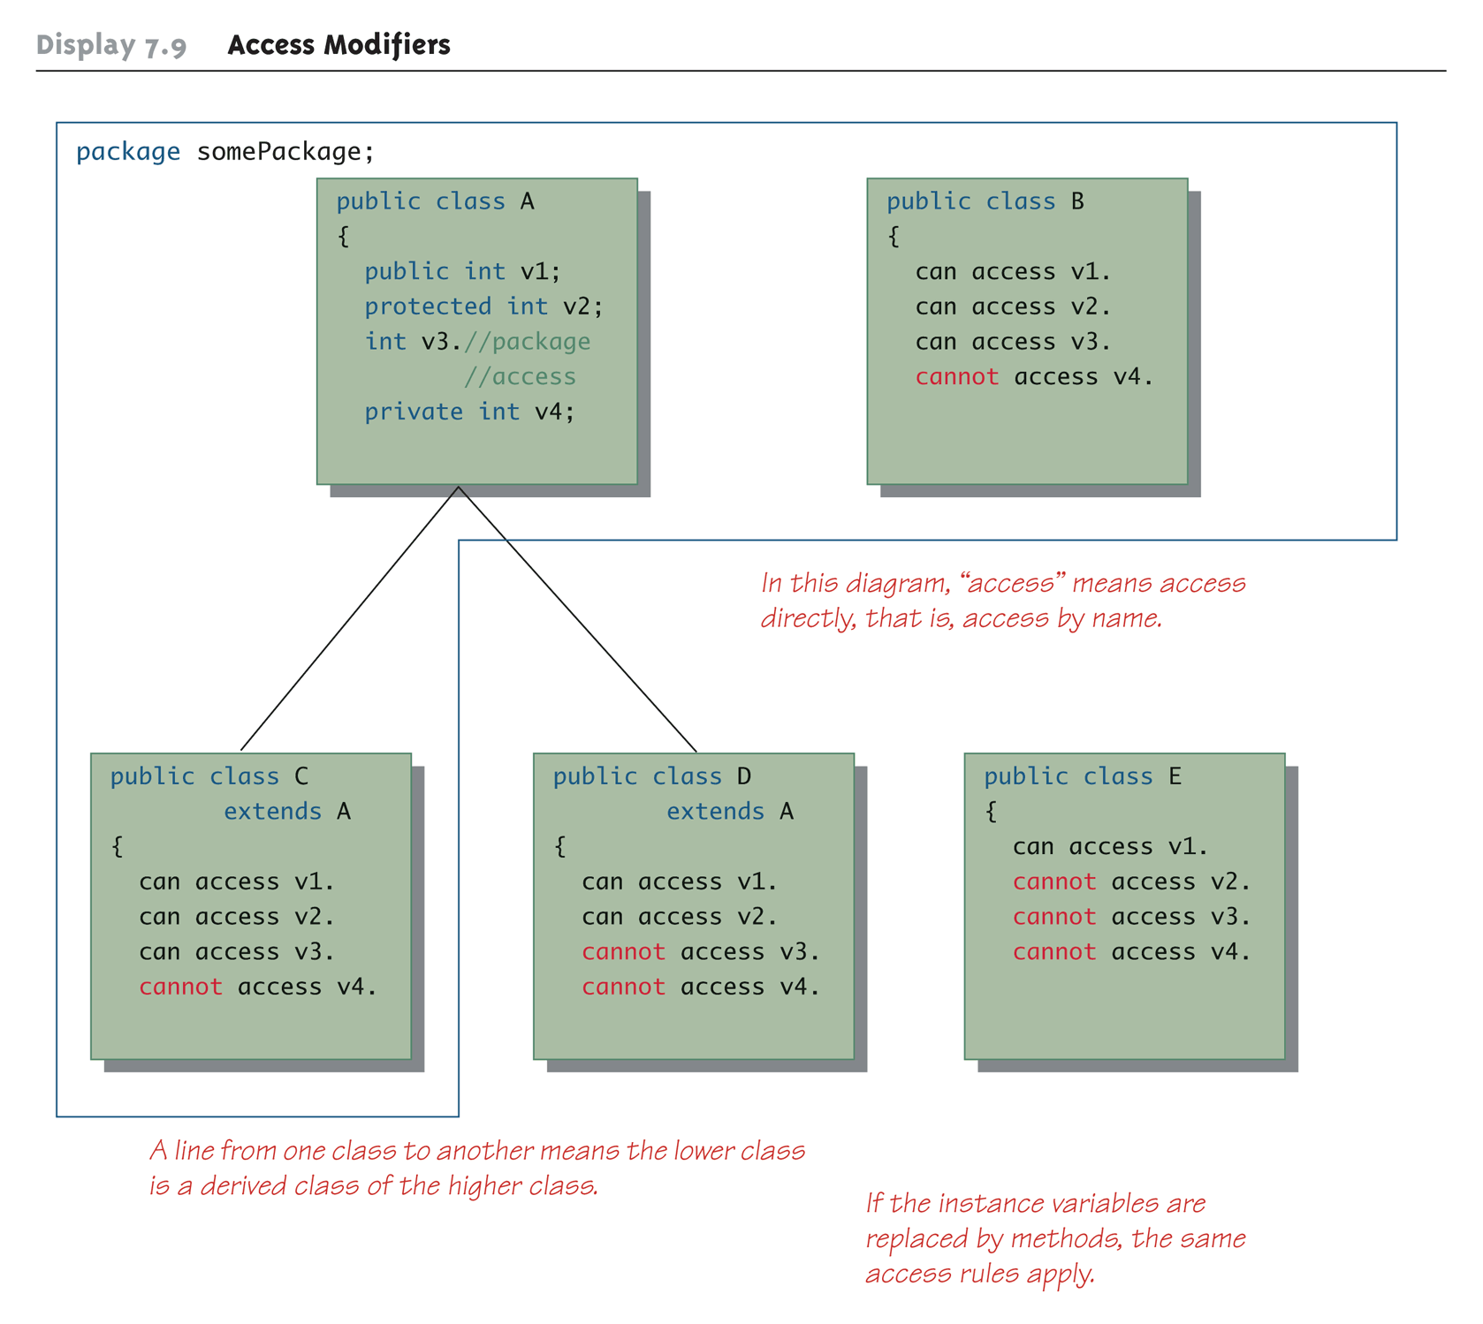
Access Modifiers
Notes:
14

Slide 15
Tip: Static Variables Are Inherited
Static variables in a base class are inherited by any of its derived classes
The modifiers public, private, and protected, and package access have the same meaning for static variables as they do for instance variables
Notes:
15

Slide 16
UML Inheritance Diagrams
Typically, a UML class diagram shows only as much as is needed for the design task at hand.

Slide 17
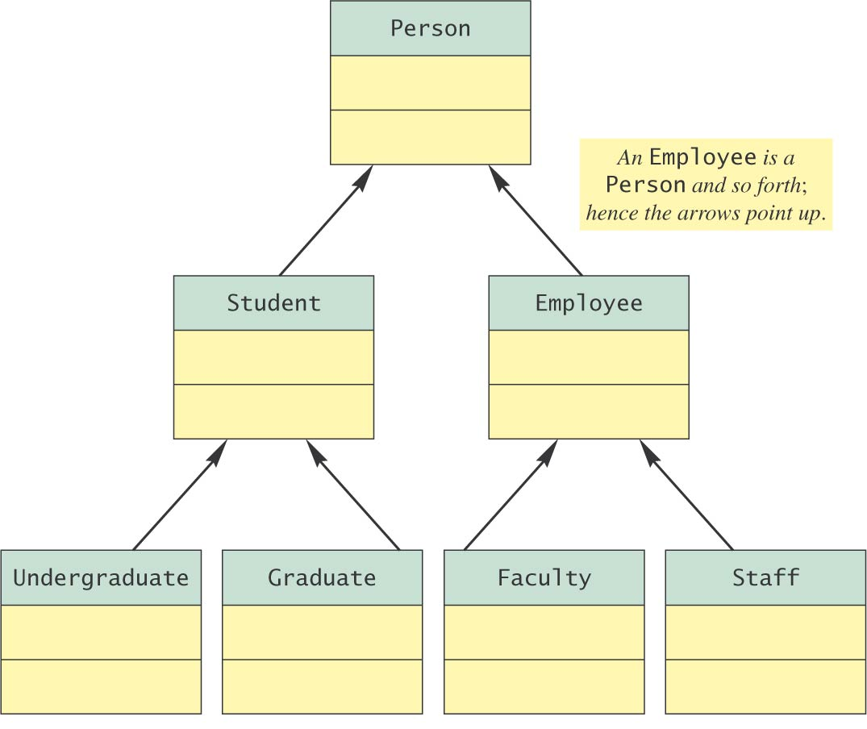
UML Inheritance Diagrams

Slide 18
UML Inheritance Diagrams
An arrowhead points from a derived class to its base class, indicating an is-a relationship.
For example, a Student is-a Person.
Inherited instance variables and methods can be found by following the arrowheads.

Slide 19
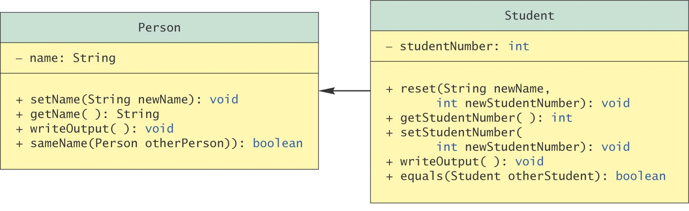
UML Inheritance Diagrams
More details of the inheritance hierarchy
UML Inheritance Diagram of Person and Student Classes

Slide 20
File AccountTester.java
01: /**
02: This program tests the BankAccount class and
03: its subclasses.
04: */
05: public class AccountTester
06: {
07: public static void main(String[] args)
08: {
09: SavingsAccount momsSavings
10: = new SavingsAccount(0.5);
11:
12: CheckingAccount harrysChecking
13: = new CheckingAccount(100);
14:
15: momsSavings.deposit(10000);
16:

Slide 21
File AccountTester.java
17: momsSavings.transfer(2000, harrysChecking);
18: harrysChecking.withdraw(1500);
19: harrysChecking.withdraw(80);
20:
21: momsSavings.transfer(1000, harrysChecking);
22: harrysChecking.withdraw(400);
23:
24: // Simulate end of month
25: momsSavings.addInterest();
26: harrysChecking.deductFees();
27:
28: System.out.println("Mom's savings balance = $“
29: + momsSavings.getBalance());
30:
31: System.out.println("Harry's checking balance = $“
32: + harrysChecking.getBalance());
33: }
34: }

Slide 22
File BankAccount.java
01: /**
02: A bank account has a balance that can be changed by
03: deposits and withdrawals.
04: */
05: public class BankAccount
06: {
07: /**
08: Constructs a bank account with a zero balance.
09: */
10: public BankAccount()
11: {
12: balance = 0;
13: }
14:
15: /**
16: Constructs a bank account with a given balance.
17: @param initialBalance the initial balance
18: */

Slide 23
File BankAccount.java
19: public BankAccount(double initialBalance)
20: {
21: balance = initialBalance;
22: }
23:
24: /**
25: Deposits money into the bank account.
26: @param amount the amount to deposit
27: */
28: public void deposit(double amount)
29: {
30: balance = balance + amount;
31: }
32:
33: /**
34: Withdraws money from the bank account.
35: @param amount the amount to withdraw
36: */

Slide 24
File BankAccount.java
37: public void withdraw(double amount)
38: {
39: balance = balance - amount;
40: }
41:
42: /**
43: Gets the current balance of the bank account.
44: @return the current balance
45: */
46: public double getBalance()
47: {
48: return balance;
49: }
50:
51: /**
52: Transfers money from the bank account to another account
53: @param amount the amount to transfer
54: @param other the other account
55: */

Slide 25
File BankAccount.java
56: public void transfer(double amount, BankAccount other)
57: {
58: withdraw(amount);
59: other.deposit(amount);
60: }
61:
62: private double balance;
63: }

Slide 26
File CheckingAccount.java
01: /**
02: A checking account that charges transaction fees.
03: */
04: public class CheckingAccount extends BankAccount
05: {
06: /**
07: Constructs a checking account with a given balance.
08: @param initialBalance the initial balance
09: */
10: public CheckingAccount(double initialBalance)
11: {
12: // Construct superclass
13: super(initialBalance);
14:
15: // Initialize transaction count
16: transactionCount = 0;
17: }
18:

Slide 27
File CheckingAccount.java
19: public void deposit(double amount)
20: {
21: transactionCount++;
22: // Now add amount to balance
23: super.deposit(amount);
24: }
25:
26: public void withdraw(double amount)
27: {
28: transactionCount++;
29: // Now subtract amount from balance
30: super.withdraw(amount);
31: }
32:
33: /**
34: Deducts the accumulated fees and resets the
35: transaction count.
36: */

Slide 28
File CheckingAccount.java
37: public void deductFees()
38: {
39: if (transactionCount > FREE_TRANSACTIONS)
40: {
41: double fees = TRANSACTION_FEE *
42: (transactionCount - FREE_TRANSACTIONS);
43: super.withdraw(fees);
44: }
45: transactionCount = 0;
46: }
47:
48: private int transactionCount;
49:
50: private static final int FREE_TRANSACTIONS = 3;
51: private static final double TRANSACTION_FEE = 2.0;
52: }

Slide 29
File SavingsAccount.java
01: /**
02: An account that earns interest at a fixed rate.
03: */
04: public class SavingsAccount extends BankAccount
05: {
06: /**
07: Constructs a bank account with a given interest rate.
08: @param rate the interest rate
09: */
10: public SavingsAccount(double rate)
11: {
12: interestRate = rate;
13: }
14:
15: /**
16: Adds the earned interest to the account balance.
17: */

Slide 30
File SavingsAccount.java
18: public void addInterest()
19: {
20: double interest = getBalance() * interestRate / 100;
21: deposit(interest);
22: }
23:
24: private double interestRate;
25: }

Slide 31
File SavingsAccount.java
Output:
Mom's savings balance = $7035.0
Harry's checking balance = $1116.0

Slide 32
References
Absolute Java (5th Ed), Walter Savitch, Addison-Wesley.

